Slide 1
Based on UHMB training for Primary Care Admin Tool – Updated by Jo Morrow 29/9/2020 – V1

Slide 2
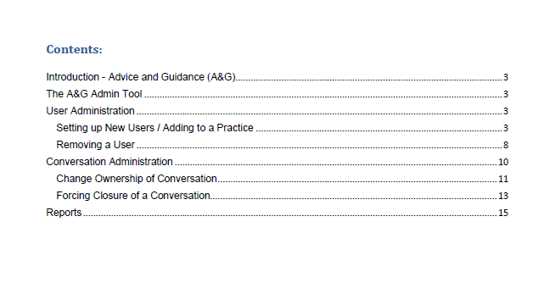

Slide 3
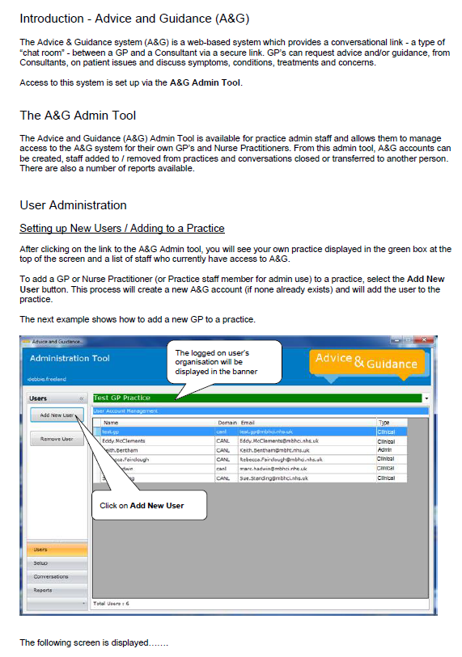
\\canlrli-group1.xcanl.nhs.uk\applications$\AGAdminTool\LCSU\AdviceAndGuidanceAdmin.exe

Slide 4
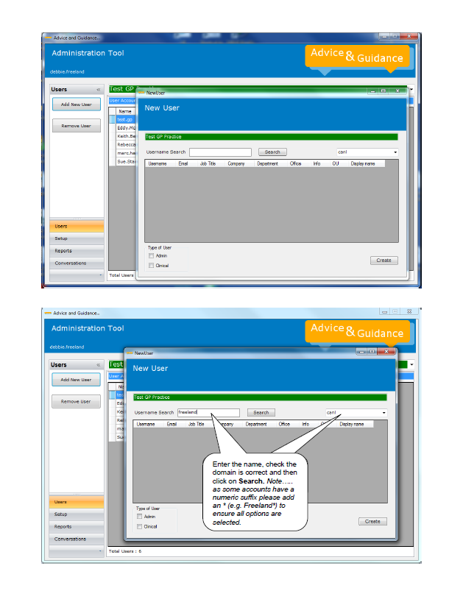
lcsu
Ensure the domain selected is ‘lcsu’

Slide 5
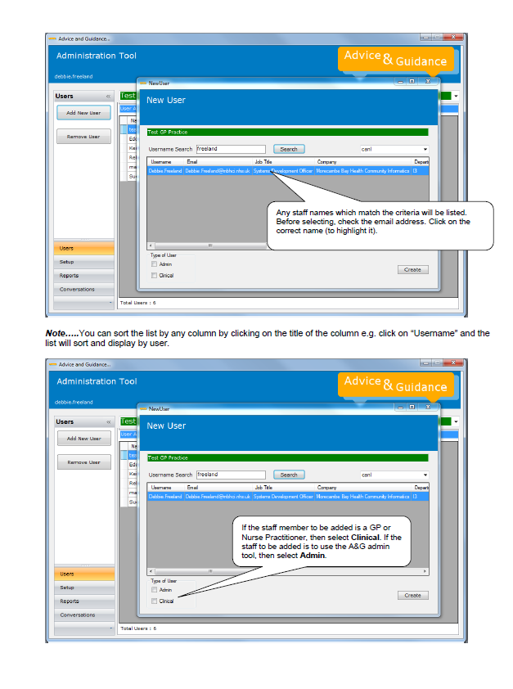

Slide 6
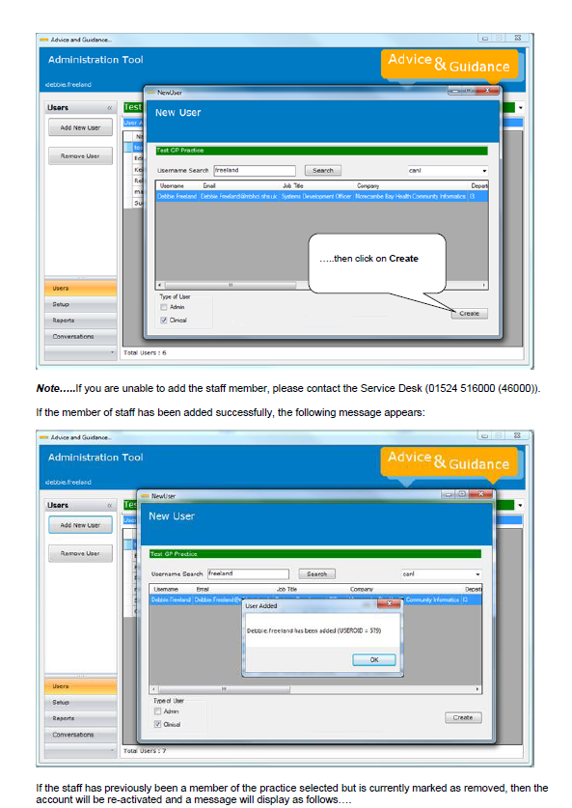
Local Service Desk

Slide 7
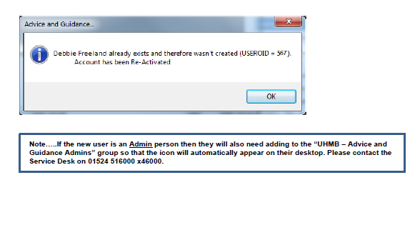
Local Service Desk

Slide 8
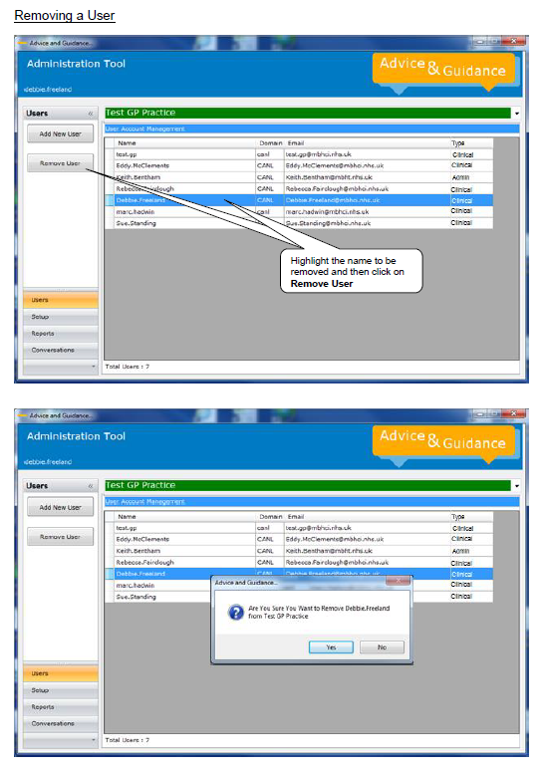

Slide 9
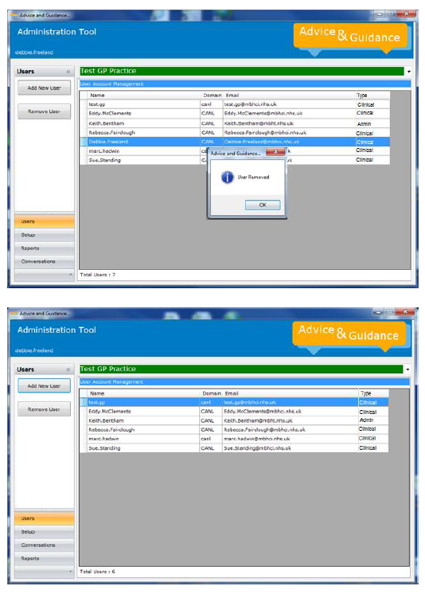

Slide 10
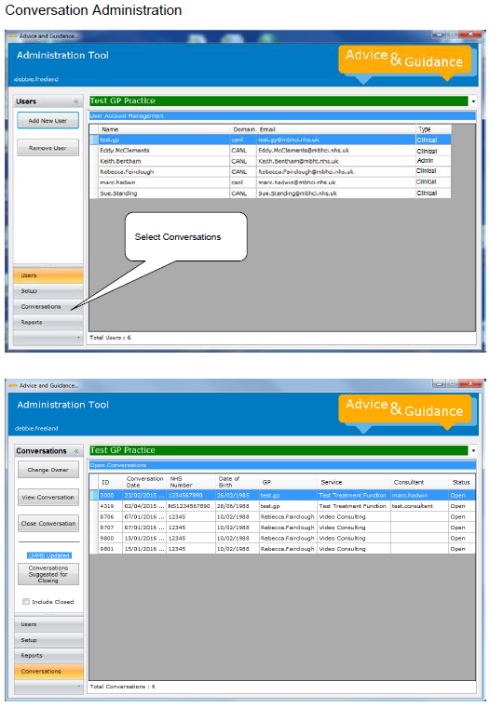

Slide 11
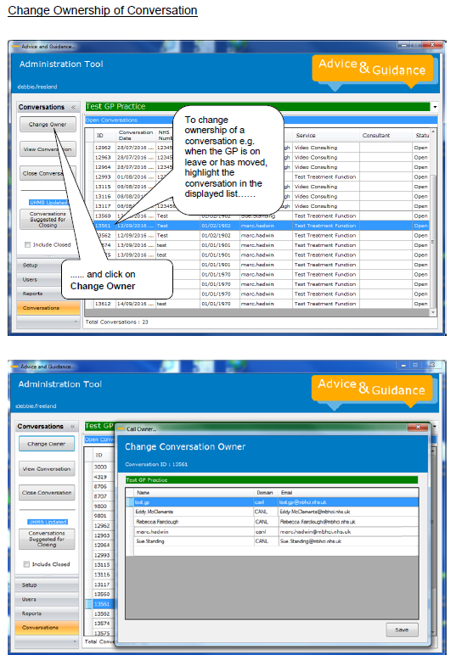

Slide 12
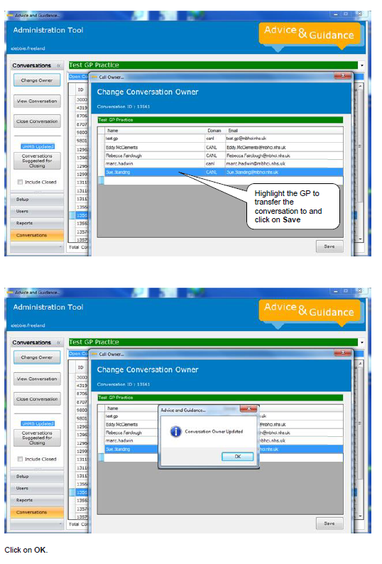

Slide 13
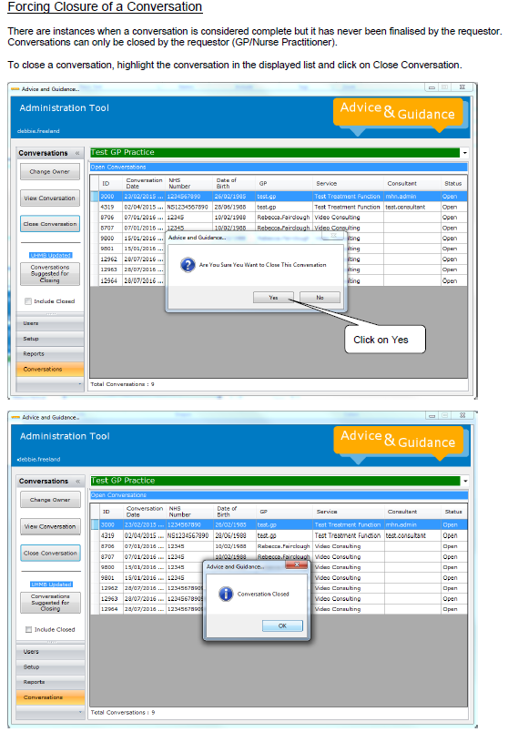

Slide 14
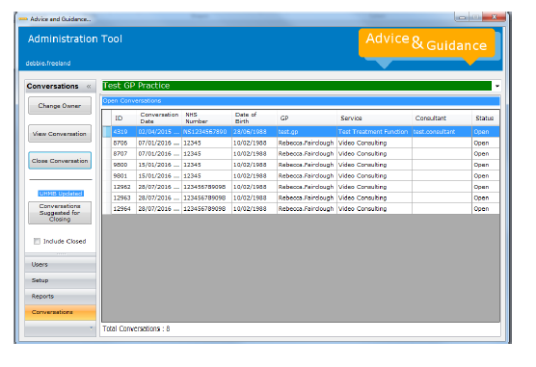

Slide 15
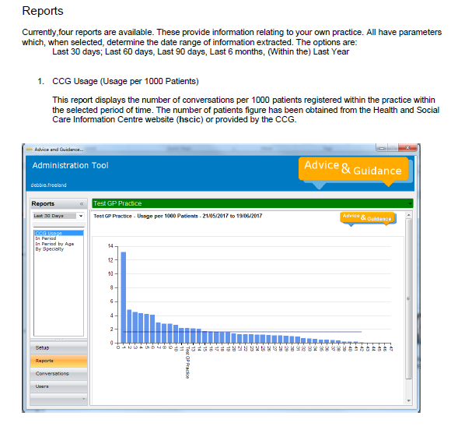

Slide 16
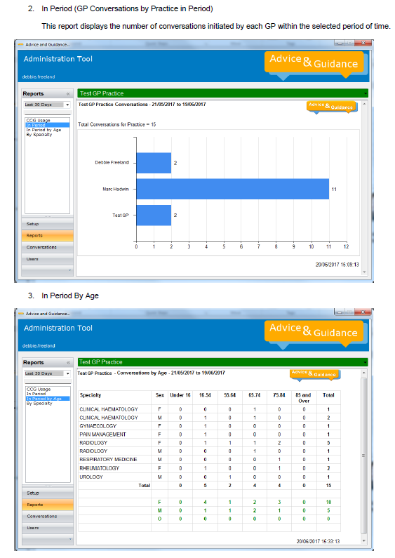

Slide 17
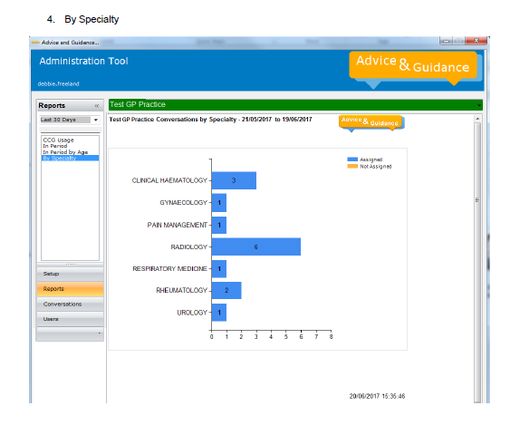

Slide 18
Thank you for completing the Advice & Guidance training
for
Practice A&G Admin Staff
If you require any further assistance please contact your local service desk

